Slide 1
A History of Pride Uprisings
As told by Miki Demeter for DefCon Furs 2020

Slide 2
Pride 2020
Content / Trigger Warning:
Police Brutality
Transphobic terms
Sex work
Produced by M. Night Shyamalan
Written by Stephen King
Directed by Quentin Tarantino
In collaboration with
Guillermo del Toro and Ridley Scott
Notes:
We all realize that 2020 is a year like nothing we have ever experienced. I don’t think a movie script by any single writer could do it justice.
This is my warning as I will cover a bit about each of these subjects

Slide 3
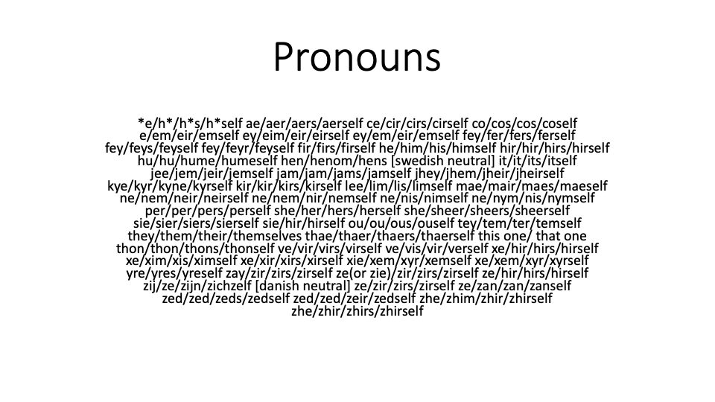
Notes:
I am not sure when pronouns and introductions came to be. But in my world, it was one of those things that is a blessing and curse. The funny thing is no one really knows when this became the norm. I truly liked it at first because when I first started to transition for the third time the majority of people no longer mis-gendered me. But then I see friends who have decided not to physically or medically transition. This is where the curse part comes in. When you do not meet the societal physical norms for the gender you identify as and you tell people your pronouns and you get the “LOOK”. The discerning look like “Really??” I have seen it many times. It really shouldn’t bother me, but it still does to this day. Today I pass well enough that I am only mis-gendered on the phone. Most people today are very aware of presentation and that it may be deceiving. Most people I know really do try. This is a difference between those that try vs those that ignore people’s feelings.

Slide 4
Dave – Jamie - Dave
A lesson in humility
Even those who have lived and understood mess up
🤦🏽‍♀️
Notes:
I who have lived with this my entire life made an unconscionable mistake
Accidentally outing a co-worker.
Tell Dave story
Why did I use HE pronouns
Jamie decided to detransition and return to being Dave
How many here introduce themselves with name and preferred pronouns?
How many people here have problems with pronouns?
How many of you make mistakes?
What is the most hated pronoun (anecdotal evidence only)?

Slide 5
They/Them - The most hated pronoun (anecdotal only)
"There is someone on the phone for you." "What do they want?”
“There is someone at the door.” “Tell them to go away.”
“He’s as lazy as they come”
Notes:
They has been used in the singular form since the 16th century so it isn’t something new by any means.
If you truly cannot get by the plural argument then might I suggest. A non-binary person identifies as neither of the binary genders but somewhere on a fluidic spectrum.. So consider they have a plurality of genders and then They/Them fits the bill

Slide 6
HB2
Trans people thrust into the spotlight
Notes:
I am not sure how it happened or when it really happened, but the one event that is always in everyone’s mind is March of 2016 when HB2, also known as House Bill 2 was passed in North Carolina. Suddenly the issue of Transgender people using a bathroom matching their identified gender comes to the forefront of everyone’s daily news. How did this happen I ask? Better yet why?

Slide 7
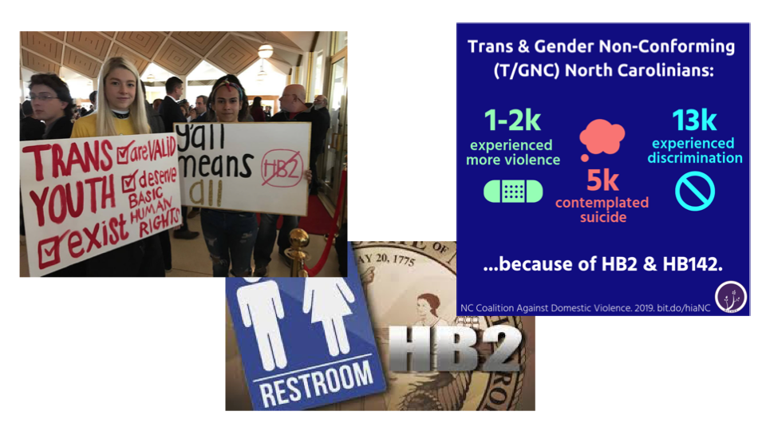
Notes:
Across America with one event Trans people were thrust into the spotlight of daily news stories. Slogans were created, “Flush Discrimination”, “Y’all means ALL”, “No men in women’s bathrooms”. These slogans were developed and weaponized by both sides of the argument. To what end I ask. This has been around for many, many years. It is nothing new and yet it was decided that it needed to be a political issue. No consideration for anyone, just talking points to inflame the masses on each side. Still even today the Supreme court questioning on landmark cases for LGBTQ discrimination centered around bathrooms and locker rooms.
Tell story of Atlantic City
How can an underrepresented minority suddenly be equated to a single issue?
We forget the real people that we are talking about. The lives they have lived the people and friends they have touched and suddenly make their entire existence about bathrooms..
WHY?

Slide 8
Oregon LGBTQ Protections
In 1928 mutual masturbation was criminal.
Oregon decriminalized same-sex sexual activity in 1972
Since January 1, 2008, Oregon has banned discrimination in employment, housing, and public accommodations based on both sexual orientation and gender identity. The protections were added by the Oregon Equality Act, signed into law by Governor Ted Kulongoski on May 9, 2007
Notes:
Many laws that were on the books were used to harass LGBTQIA folks for many years. It wasn’t until 12 years ago that Oregon passed its first anti discrimination law. I was 53 years old then.
Citation:
Oregon Governor Ted Kulongoski Signs Basic Fairness Legislation: House Bill 2007 and Senate Bill 2". Salem News. May 9, 2007.

Slide 9
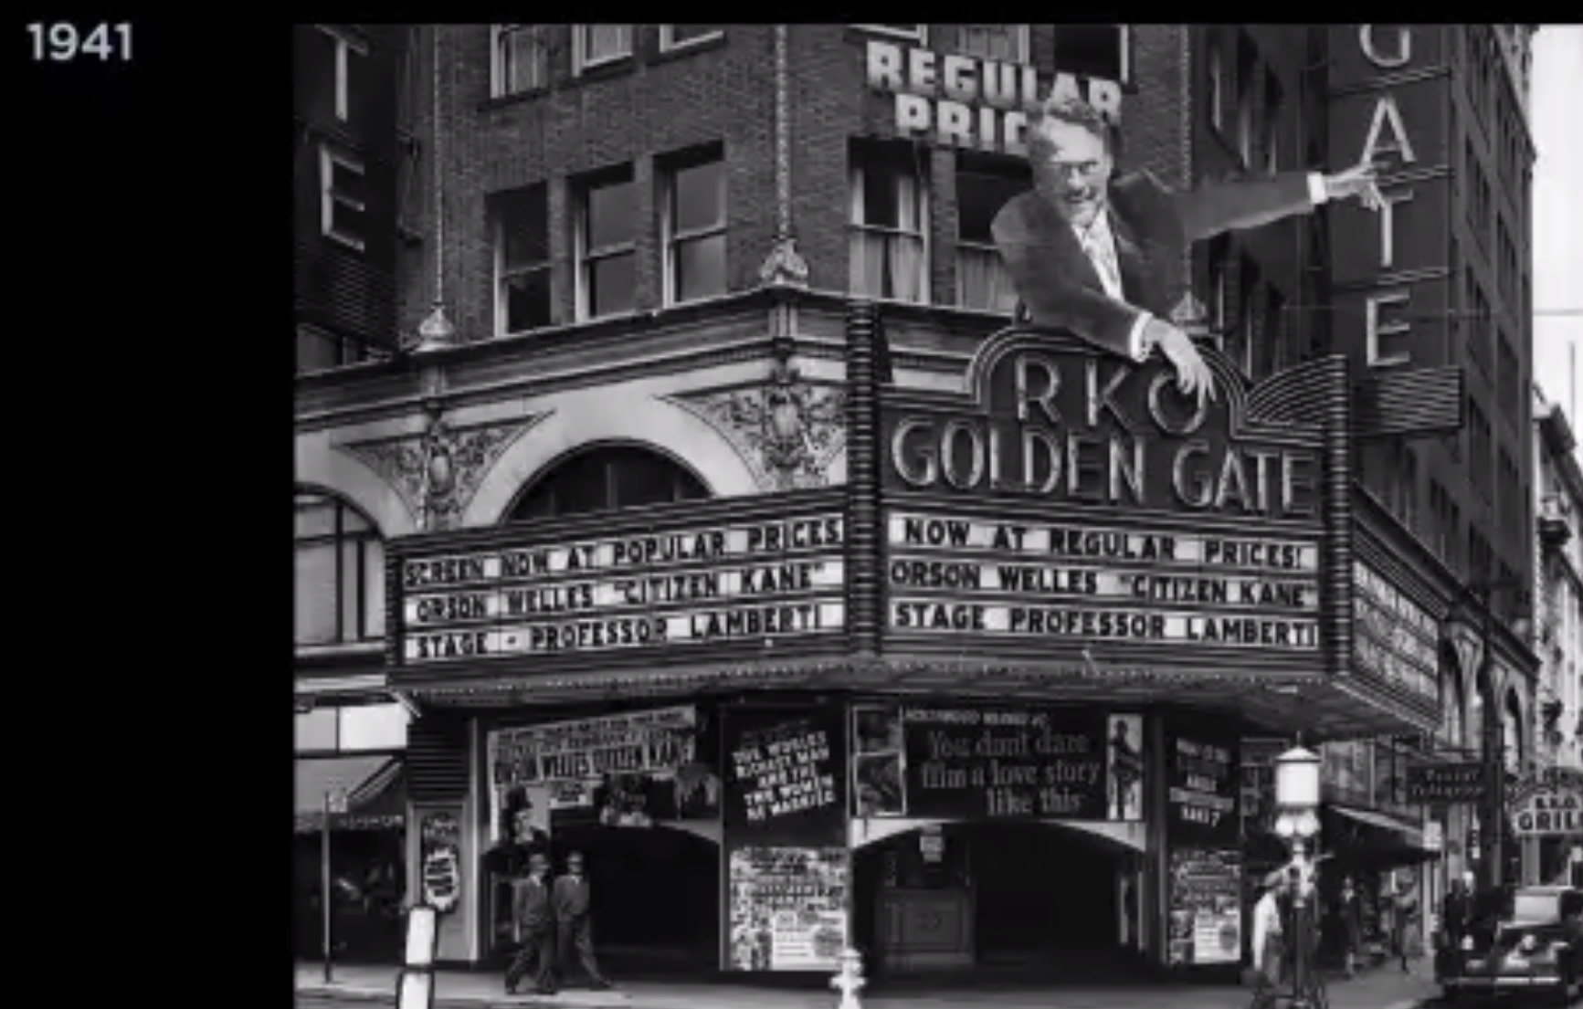
California LGBTQ Protections
Published in 1898, the General Orders of the San Francisco Board of Supervisors, Order No. 1587 §20 states no person shall “[a]ppear in a public place naked, or in a dress not belonging to his or her sex, or in an indecent or lewd dress” or be guilty of a misdemeanor punishable by a fine “not exceeding one thousand dollars”, imprisonment “not exceeding six months”, “or by both such fine and imprisonment”.
The first gender identity guidelines were approved December 10, 1998.
Discrimination protections regarding sexual orientation and gender identity or expression were adopted statewide in 2003
Notes:
The law that was used by police to harass LGBTQIA people, most notably Transgender people, was this law. They would round up Drag Queens, Cross-Dressers, Transvestites, and Transexuals (transgender was not a term used at this time), yes many of the worst of the vernaculars used in one sentence, and load them into paddy wagons and charge them with impersonating a woman. In 1998 California published their first Gender Identity guidelines. Guidelines… Not a law… It wasn’t until 2003 that California put in place discrimination protections for sexual identity and gender expression. I was 48 years old.
Why is this important.. I am going to tell you two stories on opposite sides of the US. We all have heard about Stonewall in 1969, well that was the year I arrived on the streets of San Francisco as a runaway. I was 14yrs old.

Slide 10
2019 50th Anniversary of Stonewall
Trans Women of Color throwing bricks at police
Notes:
2019 marked the 50th anniversary of Stonewall. How many here know what Stonewall was famous for and why it is a pivotal point in LGBTQ freedoms? June 28, 1969 a police raid took place at the Stonewall Inn in Greenwich Village neighborhood of Manhattan. This was one of a few places where trans people, drag queens, sex workers male and female (yes, my intention was to use biological terms because it was very biological in those years) were able to be themselves. Police routinely raided these bars and would beat and arrest many.

Slide 11
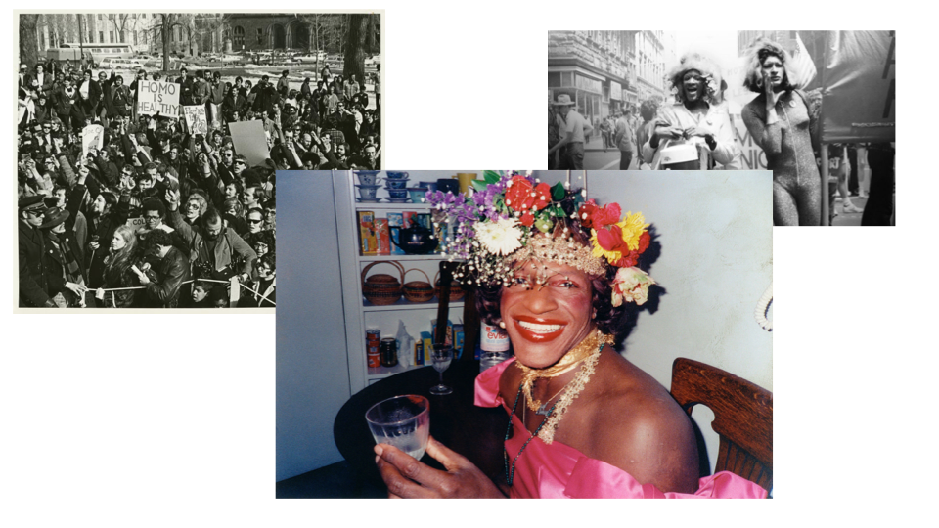
Notes:
It all came to a head on that night in June. The ensuing riots that took place are considered to be the catalyst for the LGBT movement. We would not have Pride today if it was not for Trans women of color throwing bricks at police. The LGBTQ movement started here and continues to this day. We cannot stop, we must be diligent as others try to remove everything those before us fought so hard to insure we have.
Marsha P. Johnson and Sylvia Rivera
This is important to me as I grew up in these times on the West Coast.

Slide 12
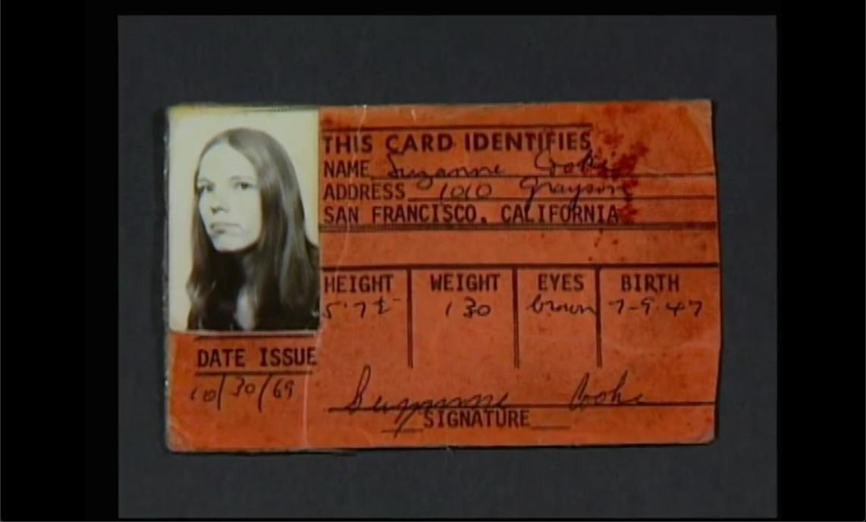
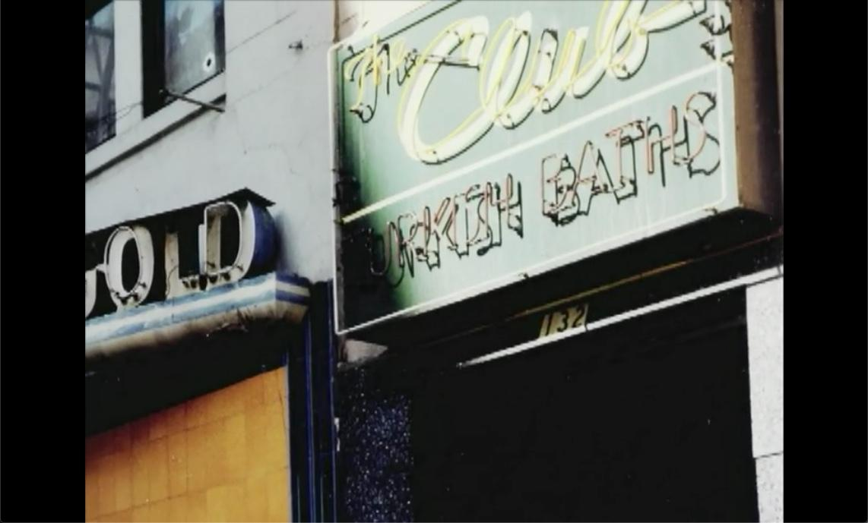
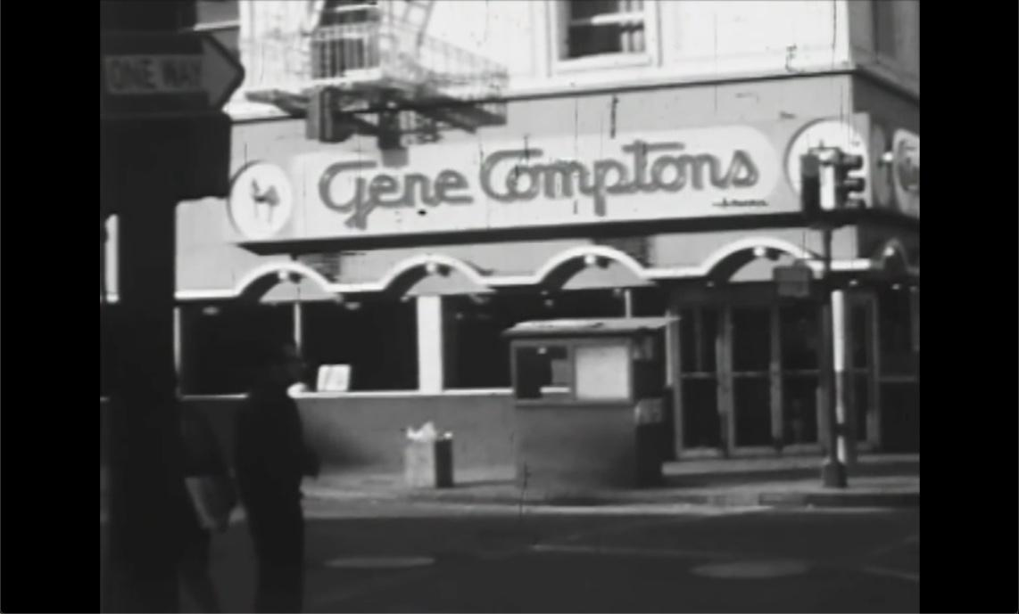
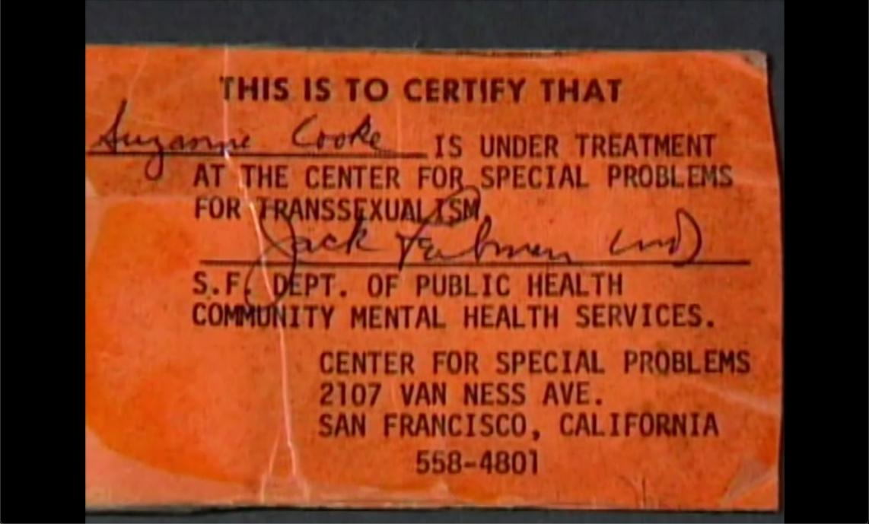
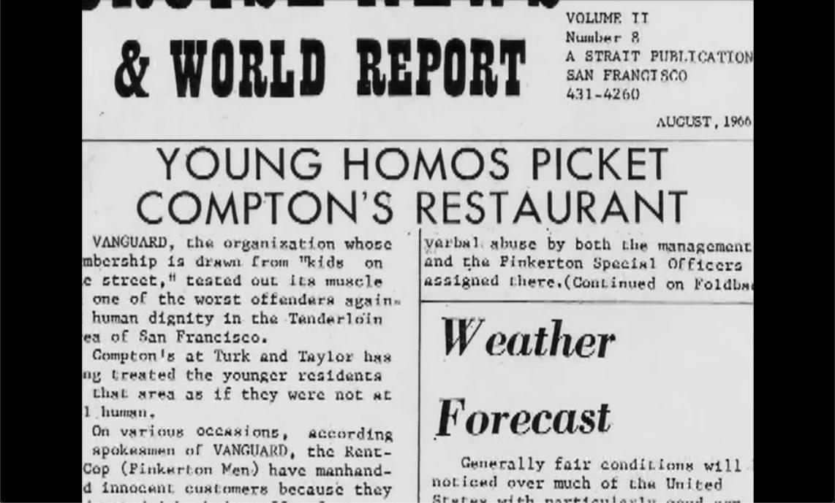
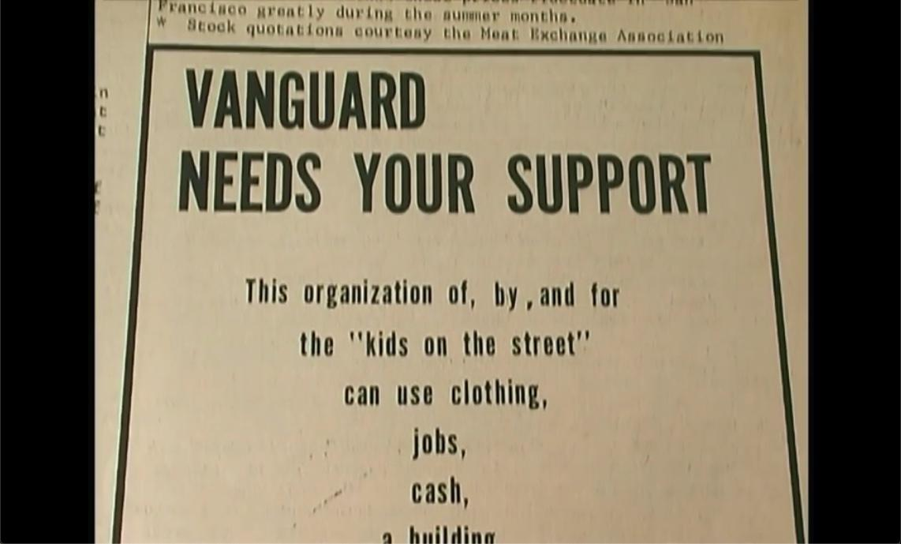
P
R
I
D
E
R
E
A
L
e
m
c
o
s
p
c
v
e
e
d
e
n
p
a
e
e
r
s
e
f
g
e
t
p
s
i
n
e
a
c
h
t
i
s
t
n
g
t
y
a
s
t
i
d
e
t
t
n
y
c
e
Notes:
The first meal I ate in San Francisco was at a small cafeteria named Gene Compton’s on the corner of Turk and Taylor. Decent food and cheap. This was to become one of my regular places to hang out and get out of the weather, exactly what I needed, as a male hustler (child sex worker) considering money was not a luxury I had much of and I certainly had no place to stay most of the time. I had never knowingly seen or met any drag queens, transvestites or transexuals(i.e.Transgender women) before arriving in San Francisco and started coming to this restaurant. Compton’s was a place where every evening after about 8-10pm they would congregate and take up all of the window booths. A few of my friends (also sex workers) and I knew some of the women from working the same locations. Many of the women were also survival sex workers due to the discrimination they faced in employment. It was not long after that I was invited to sit with them and hear the stories they told about the harassment they received at the hands of the police. I had not seen a lot of it personally, but I tried to stay away from the police as much as possible. I was told about the night they had a riot there. I had no idea how significant these conversations were until much later in my life. These are the women (TWOC, White Women), sex workers both men and women, drag queens, weekend warriors (those who presented as male until the weekends) that took me in gave me places to stay. Made sure I had something to eat when I didn’t have money. It did not matter to them who I was or why I was there. I was just considered part of their community, part of their family. These are the women who taught me that what I had felt all my life was real and not something to be feared not anything to be ashamed of, but something to revel in, to realize who I was and to live my best life. These women, this community, taught me, no they really molded my feelings, and my beliefs into the person I am today and for that I am grateful.
Anyway let’s get on with the story about what took place 3 yrs before I came to San Francisco.
Late summer of 1966 in the Tenderloin district of San Francisco. The Gene Compton’s cafeteria was the place for everyone to gather and have a good time and chat with everyone in the community. It was always an issue with the management. They did not like the LGBTQIA crowd at all and did everything they could to discourage them. After management at Compton’s had started cracking down on the transgender customers because they felt they were loitering and spending very little money at the same time causing other customers to shy away. Compton’s instituted a service fee directed directly at the trans customers. One night a group of transwomen having a good time got to loud and the management called the police to have them removed. Police brutality of LGBTQ folks was well known and on this night things changed forever. “When one of these known officers attempted to arrest one of the transwomen, she threw her coffee in his face”. That started the riot. Tables were dumped, glasses and bricks thrown at the police all of the widows were broken out and it spilled into the street. The next day transgender customers were not allowed in. A protest was arranged with the community coming together. Every window that had been replaced was broken again in the aftermath. This marked the beginning of transgender activism in San Francisco. According to Susan Stryker, Compton's Cafeteria riot was “the first known incident of collective militant queer resistance to police harassment in U.S. history”. “Many of the militant hustlers and street queens involved in the riot were members of Vanguard, the first known gay youth organization in the United States, which had been organized earlier that year with the help of radical ministers working with Glide Memorial Methodist Church, a center for progressive social activism in the Tenderloin for many years.” In the years following the Compton’s Riot services for the transgender community started making an appearance in San Francisco. All of this culminated in the creation of National Transsexual Counseling Unit (NTCU). This according to many sources was the first of its kind anywhere in the world. Originally called the Transexual Counseling Unit with services directed to the transgender community in the San Francisco area, expanded its offerings across the US and changed the name to the NTCU to reflect this. Reed Erickson was responsible for much of the funding supporting these activities. Reed the founder of Erickson Educational Foundation, was an American transman known for his philanthropy and trans activism. The EEF was known for supporting organizations such as the Harry Benjamin Foundation and the Johns Hopkins Gender Identity Clinic. The EEF also functioned as an information and counseling resource, referral network of physicians and psychologists and providing informational resources for transgender people and their families.
Citations:
Boyd, Nan Alamilla (2004). "San Francisco" in the Encyclopedia of Lesbian, Gay, Bisexual and Transgendered History in America, Ed. Marc Stein. Vol. 3. Charles Scribner's Sons. pp. 71–78.
Gay L.A.: A History of Sexual Outlaws, Power Politics, and Lipstick Lesbians. Basic Books. pp. 1–2. ISBN 0-465-02288-X
Screaming Queens: The Riot at Compton's Cafeteria (documentary film by Victor Silverman and Susan Stryker, 2005)
Stryker, Susan. Transgender History. First Printing edition. Berkeley, CA: Seal Press, 2008.
Benjamin, Harry: The Transexual Phenomenon, THE JULIAN PRESS, INC. PUBLISHERS, New York (1966), http://www.mut23.de/texte/Harry%20Benjamin%20-%20The%20Transsexual%20Phenomenon.pdf
Susan Stryker Encyclopedia Copyright © 2015, glbtq, Inc http://www.glbtqarchive.com/ssh/san_francisco_S.pdf
Library and Archives of the GLBT Historical Society, www.glbthistory.org
Reed Erickson and The Erickson Educational Foundation (http://web.uvic.ca/~erick123/)

Slide 13
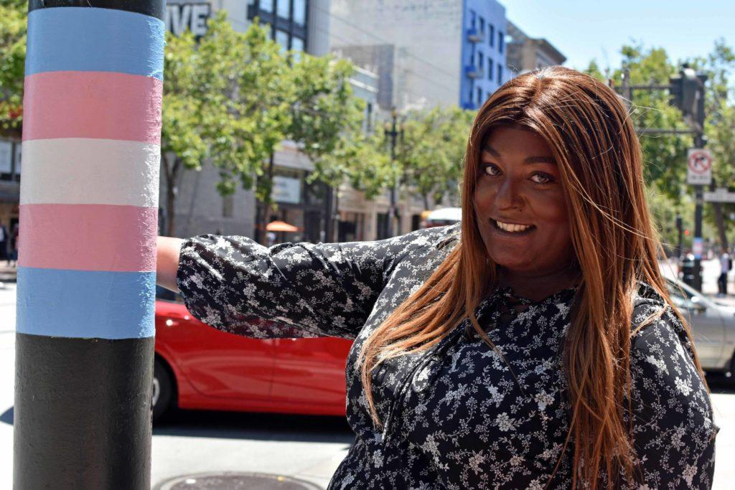
For More Information
http://www.tenderloinmuseum.org/
http://www.glbtqarchive.com/
Email: miki@pdxwit.org
Twitter: @theDawgCr8
LinkedIn: https://www.linkedin.com/in/mikide
Wordpress: https://secprincessmikid.wordpress.com/
Notes:
What has come about in the recent years in San Francisco, a transgender cultural district was established via ordinance by the San Francisco Board of Supervisors in 2017. The first of its kind transgender cultural district was originally known as Compton's Transgender Cultural District but as of March 2020 the name has been changed to The Transgender District. The name change was to avoid unintentionally honoring the transphobic cafeteria owner. It was originally named after the uprising of transgender and queer people I previously described. This is the first recognized transgender district anywhere in the world to date. In July 2019, the board allocated $300,000 in seed money to support the district. Plans for the new district include a coffee shop that will provide jobs and training for local trans people of color. I originally heard about this listening to NPR and started looking for information. I am planning to go to the museum again as this is the place that contains so many memories for me.
A lot of the Information that I presented here tonight can be found or accessed through these sites. This presentation will be available with my speaker notes and all citations allowing you to do further discovery of LGBTQIA history on your own
Citations:
Veltman, Chloe (January 28, 2019). "San Francisco's Storied Transgender Community Now Has An Official Home". NPR
Sawyer, Nuala (February 6, 2019). "The First Transgender District in the Nation Gets a New Director". SF Weekly
Tovar, Virgie (February 26, 2019). "First Ever Transgender Cultural District Co-Founded By #XLBossLady Aria Sa'id". Forbes
Ferrannini, John (March 20, 2020). "Online Extra: SF transgender district drops cafeteria owner's name". Bay Area Reporter
Rodriguez, Joe Fitzgerald (June 26, 2019). "SF posts new street signs and trans Pride flags across Compton's Transgender Cultural District". San Francisco Examiner

Slide 14
Takeaways
Remember Pride was a protest movement to bring LGBTQ rights to us all, not parties, parades, flags or corporate slogans
All people, I mean everyone, are not about single issues
Everyone has a different journey and you may never know what they have endured to get to where they are today
Everyone deserves to be treated with empathy and compassion
We are all more than our labels, labels only describe what we choose to expose to others
Notes:
What is it we need to do? What should the takeaway be from this talk?
Remember that Pride was a protest movement to bring LGBTQ rights to us all, not slogans, not flags, and not a party
In any circumstance remember all people, I mean everyone, are not about single issues.
Everyone has a journey that is different, and you may never know about what they have endured to get to where they are today. Everyone should be treated with compassion and empathy.
We are all more than our labels. Labels describe a small portion of what we choose to expose to those around us.

Slide 15
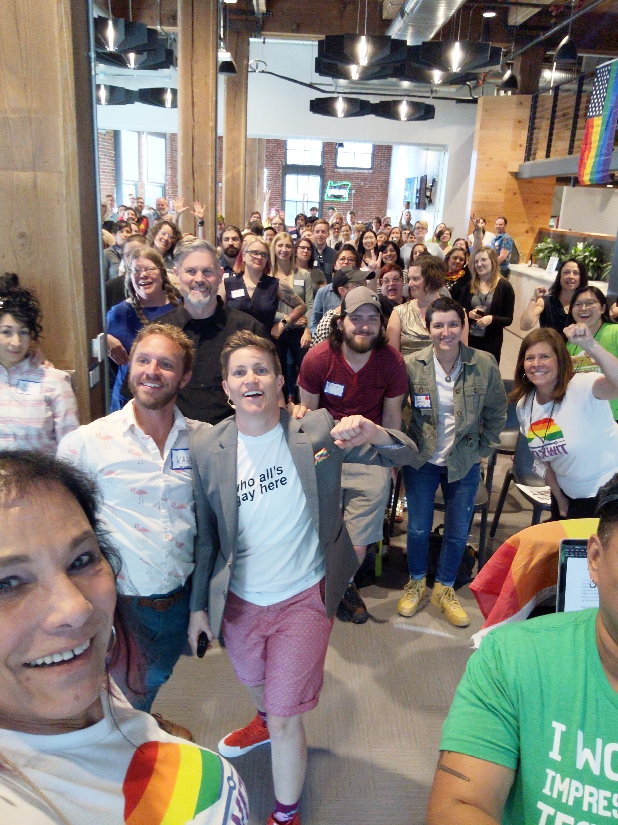
ABOVE ALL
Everyone is more than their pronouns
Notes:
No one should ever be equated to any issue or set of issues. We are all human beings with a life story and a journey still unfolding.
Above all remember “EVERYONE” is more than their pronouns…

Slide 16
So Live Your Life With
REAL PRIDE
Email: miki@pdxwit.org
Twitter: @theDawgCr8
LinkedIn: https://www.linkedin.com/in/mikide
Wordpress: https://secprincessmikid.wordpress.com/
Notes:
Your takeaway tonight is this. The people who fought for us, the women who molded me and whose shoulders I stand on would want each of us -
To live our lives with REAL PRIDE
THANK YOU

